Slide 1


Slide 2

Shopify your products online

Slide 3
Group Members Introduction
Student LMS ID
Student Name:
Project Group ID:

Slide 4

INTRODUCTION OF PROJECT
Shopify is web portal that provides various items of day by day usage for customers. Customers visit the web portal of the mall for purchasing products. Any user can apply for registration and can buy and sale products including computer/ accessories, food items, solar panels, batteries, cars etc.

Slide 5
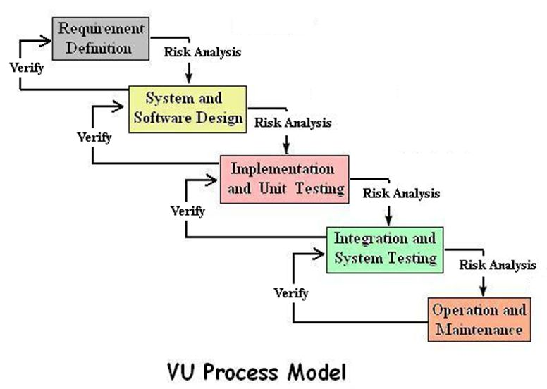
VU Process Model

Slide 6
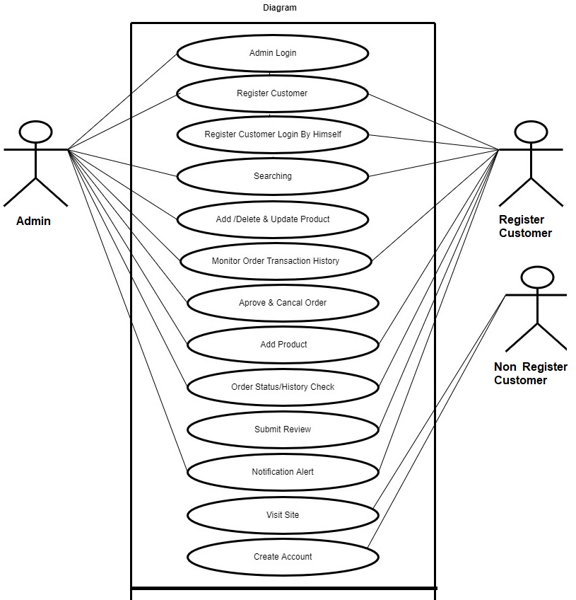
Use Case Diagram

Slide 7
Business Rules Catalog
User Registration/Sign Up, Sign In
There will be proper interfaces for user registration and Sign In for the following three types of the users of the website:
Visitor (Unregistered User)
Registered user (Customer / Client)
Registered user (Administrator)
Roles of the users will be as follow:
Visitor will be able to visit the website to search his/her relevant clothes on the website.
A user registered as a Customer/ Client will be able to place order on the website.
The Administrator (Admin) will have all the rights/privileges of information management regarding the clothes, stock management, as well as user management. Admin will approve the registration requests from the other users (customers / clients).
Email Notification and Verification
An unregistered user will register him/her on the website. On submitting the registration information, an email notification will be sent with a confirmation link to the user’s given email ID. On confirmation through link, the Admin will approve the registration requests from users. An email notification will also be sent to the registered user on approval or rejection of any request.

Slide 8
Business Rules Catalog
Admin Panel
There will be proper Admin Panel / Dashboard comprising of interactive interfaces through which the Admin will be able to add/ delete and update all information such as description, price, stock, images of Clothes. In addition, by using this Admin Panel, the Admin will be able to perform category management as well as user management (accepting /rejecting the user registration requests).
Display of Information on the website
The fabric/clothing products name, quality, material, category, company name, thumbnail image, price and number of items available in stock, new Arrival, Sale (if any), contact us, complaints, feedback by the registered users etc. should be displayed on the website in proper design. On clicking the thumbnail, the website will maximize the fabric/product image.
Placing Order on the Website
The website will allow the registered user(s) to make order against their selected items. There will be proper interfaces on the website in this regard. The user will first have to select the item to put into the shopping cart, and then will have to pass through any of the payment method i.e. through credit card or cash on delivery.

Slide 9
Confirmation Email on transaction (Order Placing):
A confirmation email on successful transaction will be sent to the user’s provided email.
Search Facility
The website will provide rich search feature through which all types of users should be able to search information on the website using different filters and keyword such as:
Fabric Type
Brand / Company Name
Category Wise
Price Wise
New Arrival
Sale
Best Sellers
Admin will also be able to search the information by user IDs.
Comments/Complaints/Feedback
The registered users will be able to submit feedback, complaints and comments against any product/item.

Slide 10
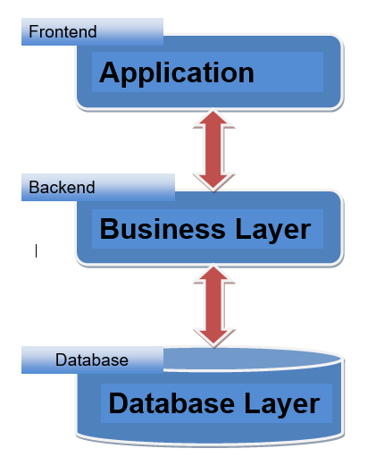
Architectural Design

Slide 11
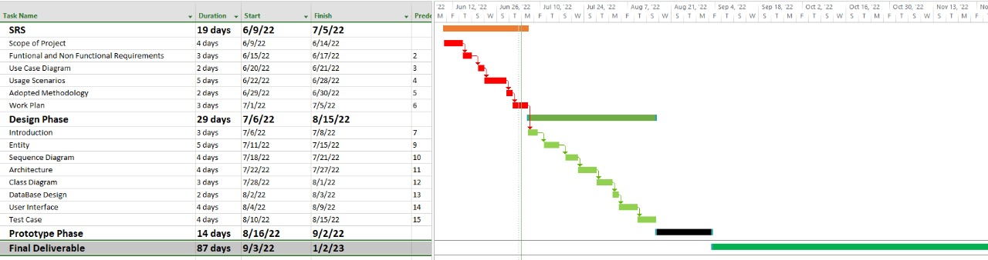
Project Schedule

Slide 12
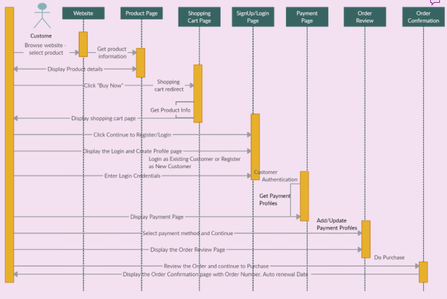
Sequence Diagrams

Slide 13
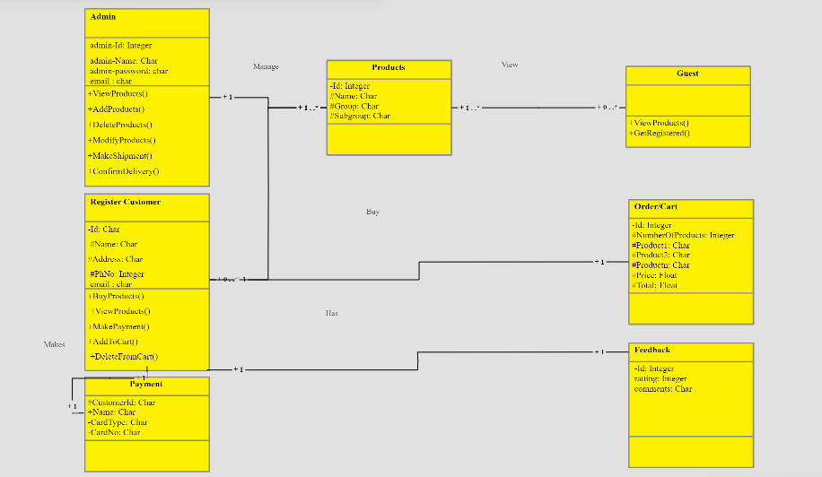
Logical Model/Class Diagram

Slide 14
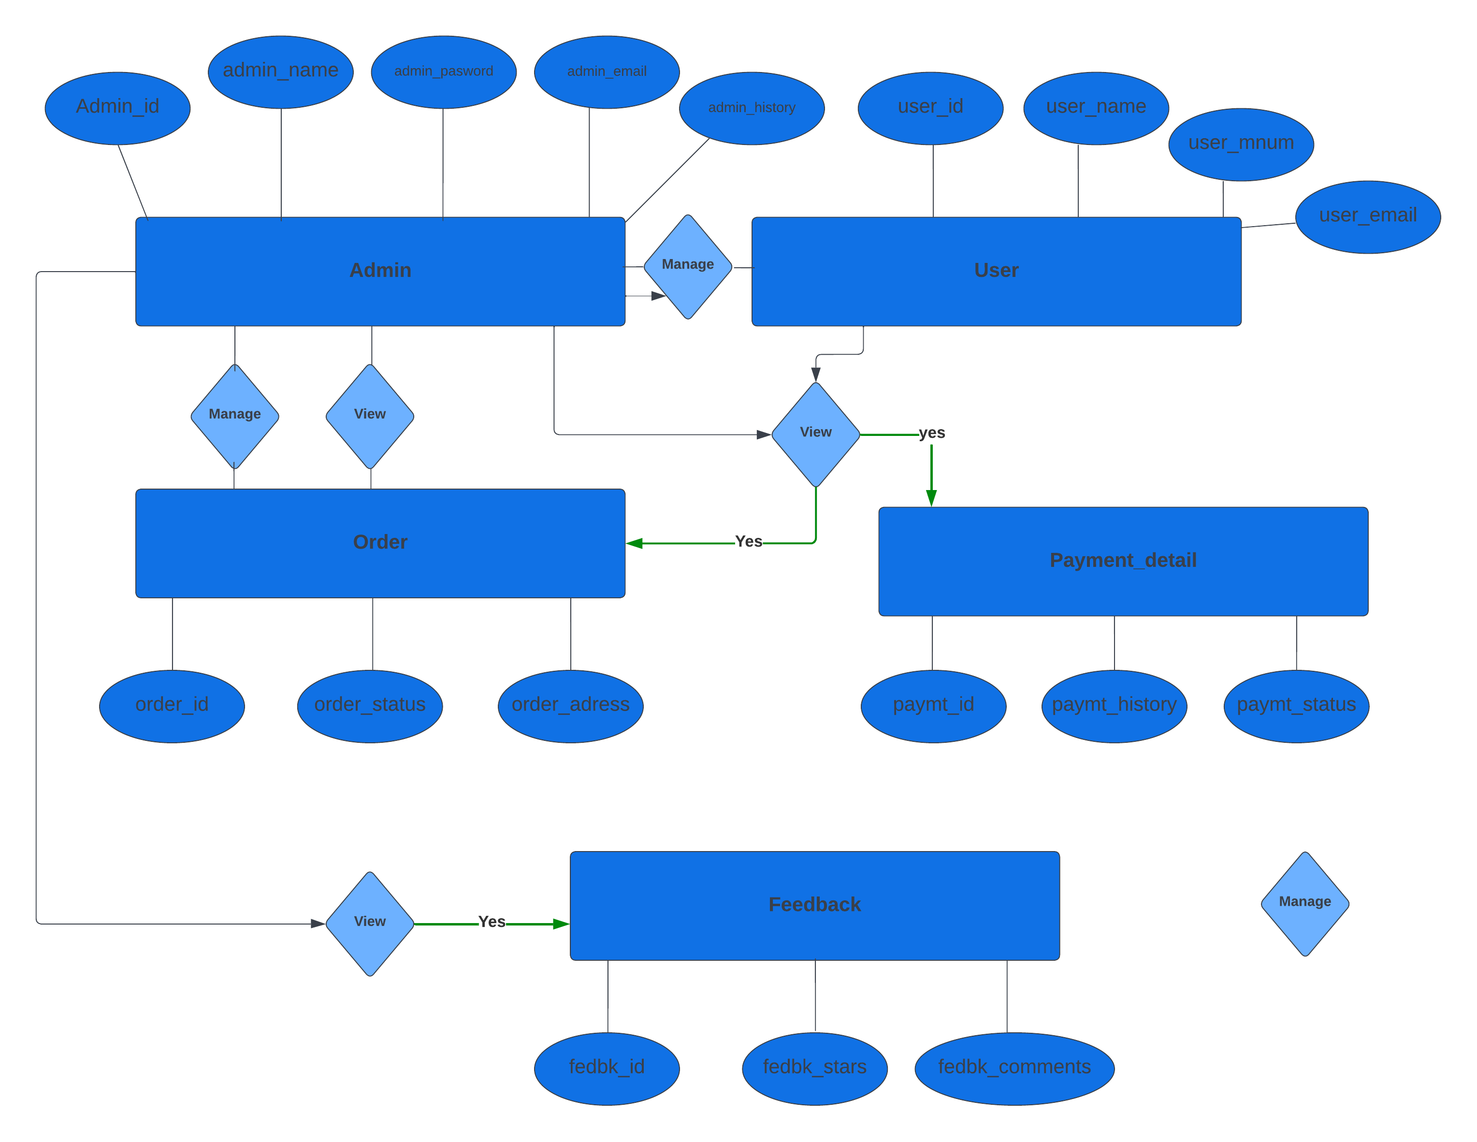
Entity-Relationship Diagram

Slide 15
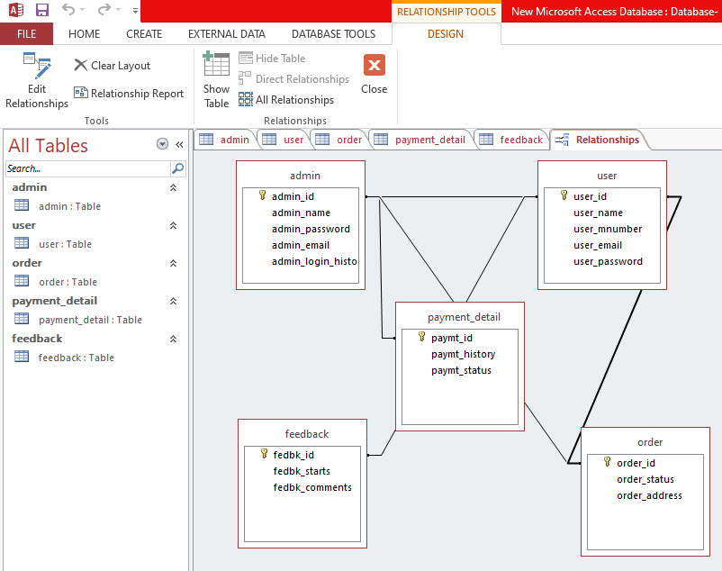
Database Diagram

Slide 16
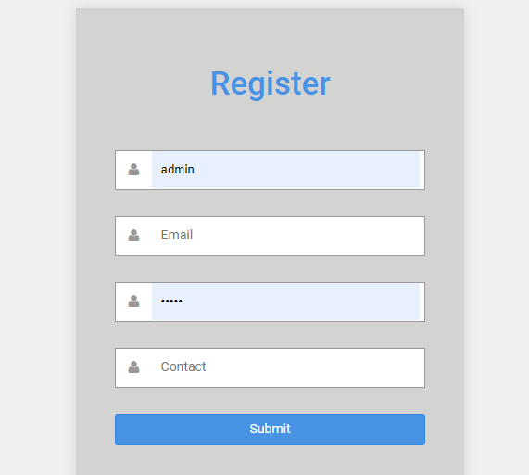
User Interfaces
Registration field

Slide 17
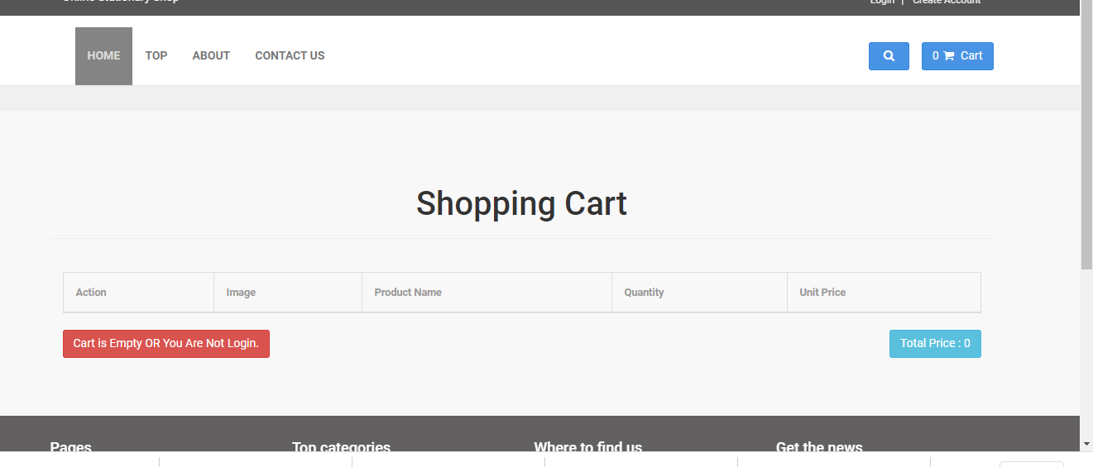
View Cart

Slide 18
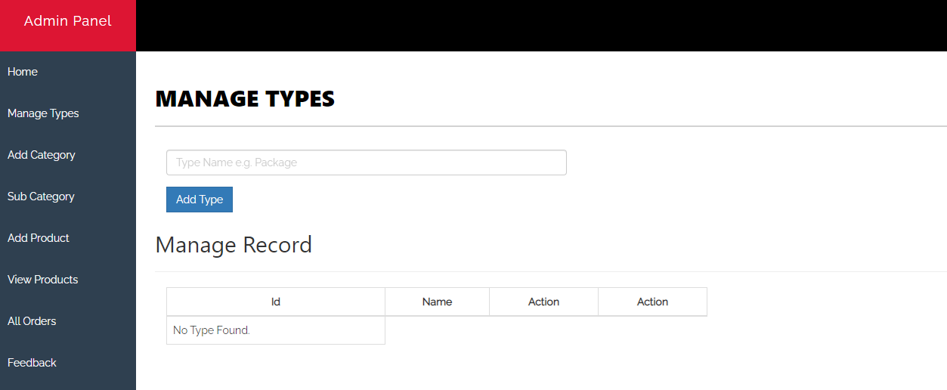
Admin of the website

Slide 19
Tools
HTML
CSS
BootStrap
PHP/MySQLi

